Slide 1
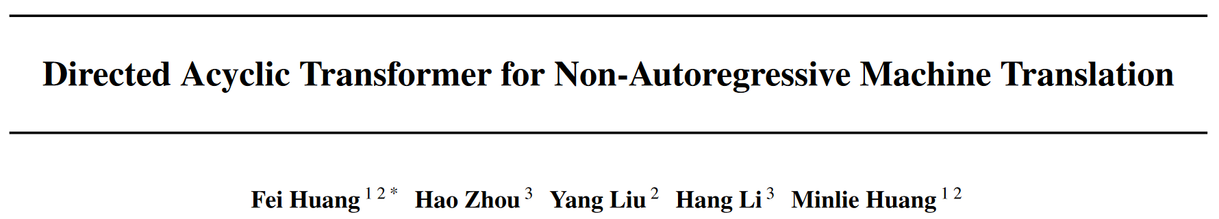
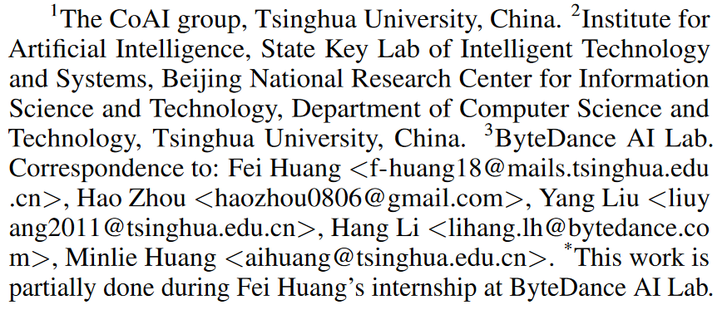
ICML 2022

Slide 2
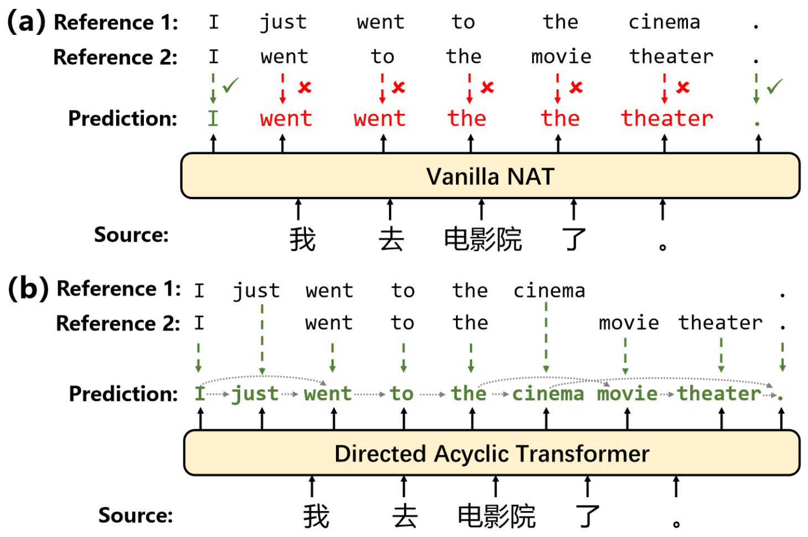
Introduction
NATs severely suffer from the multi-modality problem.
Notes:
The multi-modality here refers to the fact that there are multiple possible translations for a single source sentence.
Train -> if several references -> may learn to generate output that mixes several translations
(Even one input -> one output, semantically similar sentences can still confuse the model)
(Because based on what they learn from the corpus, multiple translations are natural)
Inference -> each token is sampled independently, still can mix several translations
Transformer does not have this problem, since they generate left-to-right, and the prefix is given.

Slide 3
Introduction
Currently, the main solution is to reduce data modalities by knowledge distillation from an AT teacher.
Current SoTA NATs heavily rely on KD. But,
Training NATs by KD makes the training process redundant.
Generally, the student model cannot outperform its teacher with a large margin.
In this paper, we propose to directly capture many translation modalities via a proposed Directed Acyclic Decoder.
Notes:
KD is effective because one model usually have one target for one input? (while in dataset there is multiple potential target)
If you have trained an AT first, why bother training another NAT? Such pre-processing makes NATs not practically used.
KD restricts the student's performance (although not realistic now)
KD actually indirectly handles the multi-modality problem. Our solution is direct.
A recent study (Huang et al., 2022b) provides a unified perspective showing that most existing methods actually modify targets or inputs to reduce the token dependencies in the data distribution, which eases the NAT training but introduces data distortion.

Slide 4
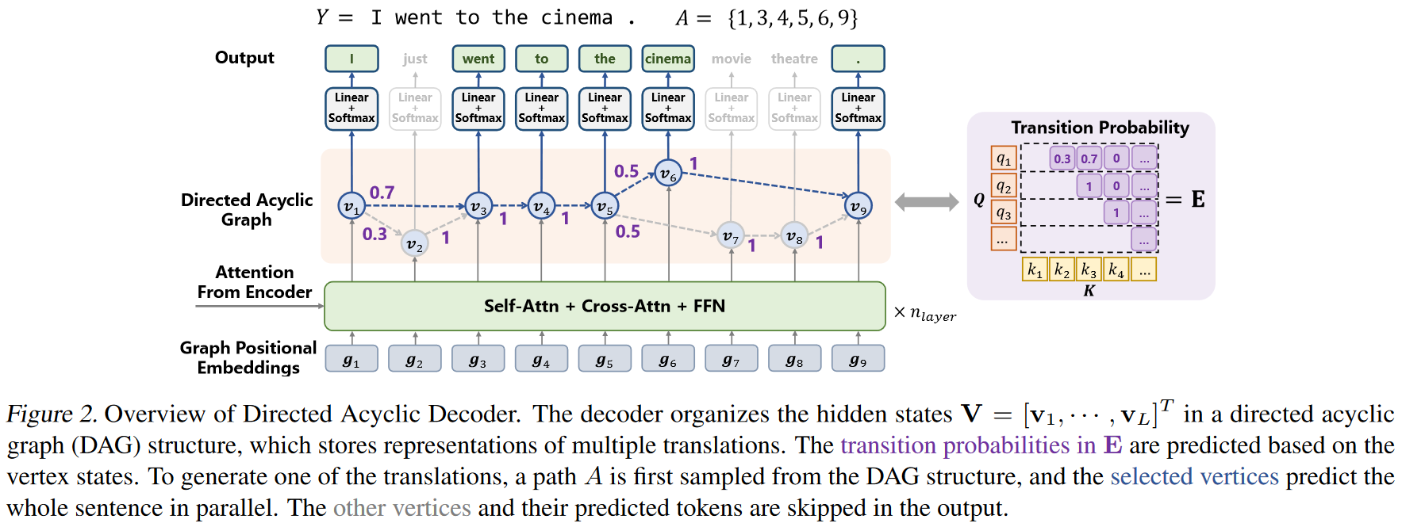
Method
Notes:
Each vertex models word distribution in specific position.
The edge represents transition between hidden states to organize words into a final sentence.

Slide 5
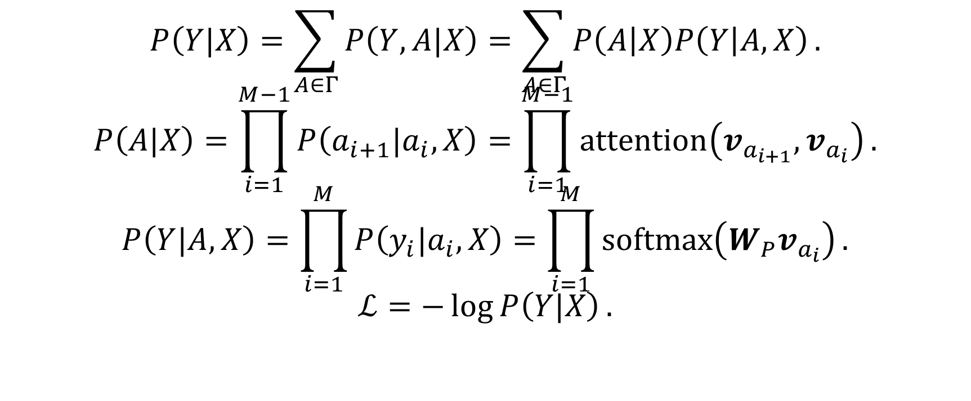
Method
$$P\left(Y|X\right)=\sum_{A∈Γ}{P\left(Y, A|X\right)}=\sum_{A∈Γ}{P\left(A | X\right)P\left(Y | A,X\right)}.$$
$$P\left(A|X\right)=\prod_{i=1}^{M−1}{P\left(a_{i+1}|a_{i},X\right)}=\prod_{i=1}^{M−1}{\operatorname{attention}\left(v_{a_{i+1}},v_{a_{i}}\right)}.$$
$$P\left(Y|A,X\right)=\prod_{i=1}^{M}{P\left(y_{i}|a_{i},X\right)}=\prod_{i=1}^{M}{\operatorname{softmax}\left(W_{P}v_{a_{i}}\right)}.$$
$$ℒ=−\log{P\left(Y|X\right)}.$$

Slide 6
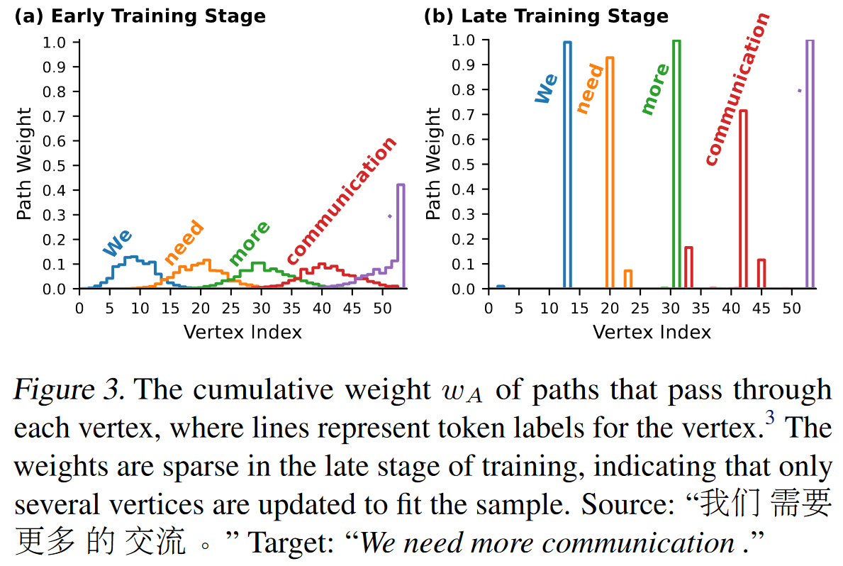
Method - training
How to train with only one reference?
Directly optimize the loss on all possible paths.
We find the objective assigns a single reference to several paths, so other possible translations are preserved on unchanged vertices.
Notes:
, and other vertices remain unchanged.
Other

Slide 7
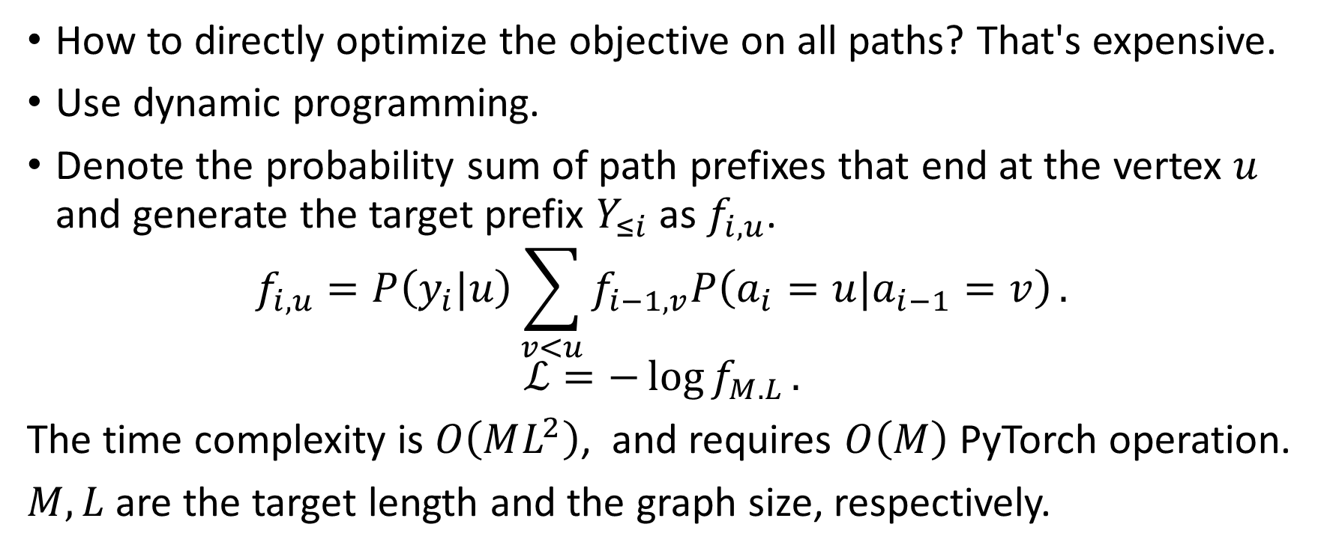
Method - training
How to directly optimize the objective on all paths? That's expensive.
Use dynamic programming.
Denote the probability sum of path prefixes that end at the vertex $u$ and generate the target prefix $Y_{≤i}$ as $f_{i,u}$.
$$f_{i,u}=P\left(y_{i}|u\right)\sum_{v<u}{f_{i−1,v}P\left(a_{i}=u|a_{i−1}=v\right)}.$$
$$ℒ=−\log{f_{M.L}}.$$
The time complexity is $O\left(ML^{2}\right)$, and requires $O\left(M\right)$ PyTorch operation.
$M, L$ are the target length and the graph size, respectively.

Slide 8
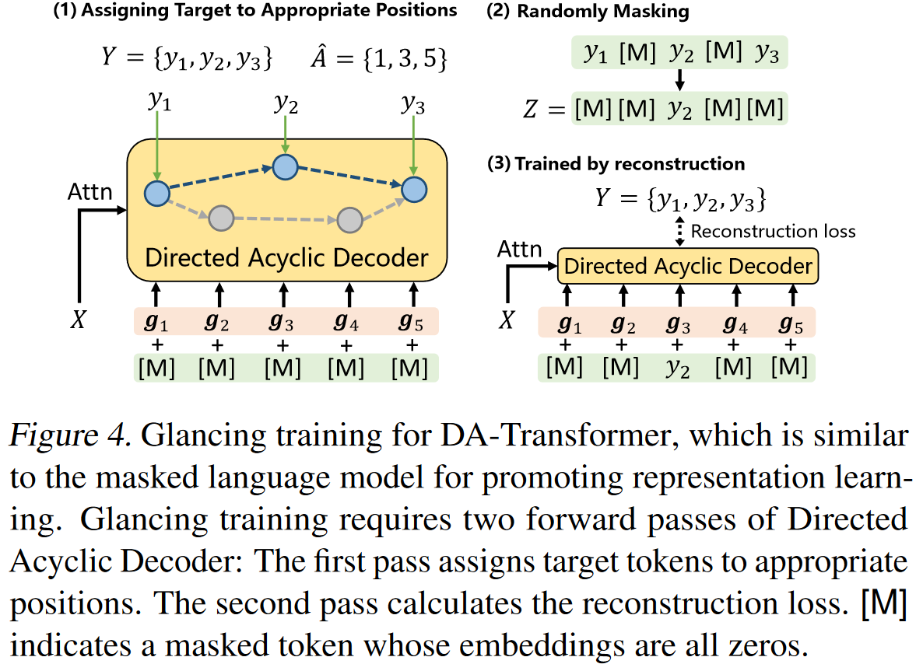
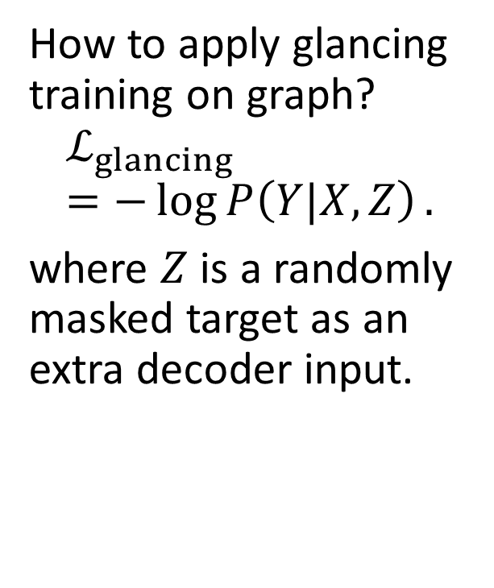
Method - training
How to apply glancing training on graph?
$$ℒ_{glancing}=−\log{P\left(Y|X,Z\right)}.$$
where $Z$ is a randomly masked target as an extra decoder input.

Slide 9
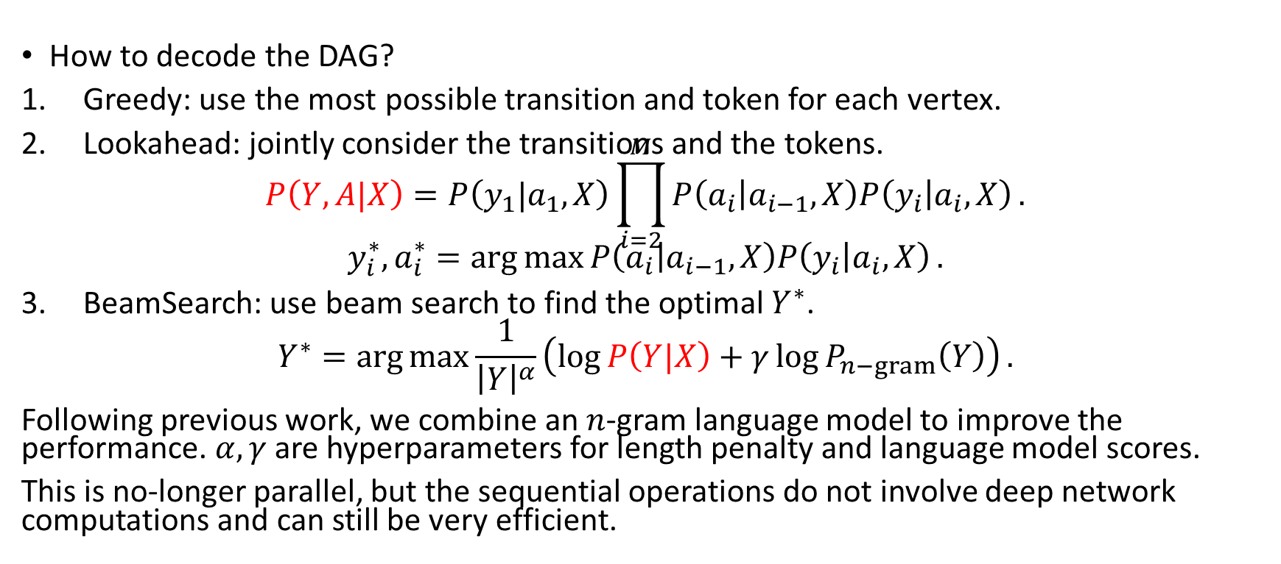
Method - inference
How to decode the DAG?
Greedy: use the most possible transition and token for each vertex.
Lookahead: jointly consider the transitions and the tokens. $P\left(Y,A|X\right)=P\left(y_{1}|a_{1},X\right)\prod_{i=2}^{M}{P\left(a_{i} | a_{i−1},X\right)P\left(y_{i} | a_{i},X\right)}.$
$$y_{i}^{∗},a_{i}^{∗}=\arg{\max{P\left(a_{i} | a_{i−1},X\right)P\left(y_{i} | a_{i},X\right)}}.$$
BeamSearch: use beam search to find the optimal $Y^{∗}$.
$$Y^{∗}=\arg{\max{\frac{1}{{\left|Y\right|}^{α}}\left(\log{P\left(Y|X\right)}+γ\log{P_{n−gram}\left(Y\right)}\right)}}.$$
Following previous work, we combine an $n$-gram language model to improve the performance. $α, γ$ are hyperparameters for length penalty and language model scores.
This is no-longer parallel, but the sequential operations do not involve deep network computations and can still be very efficient.

Slide 10
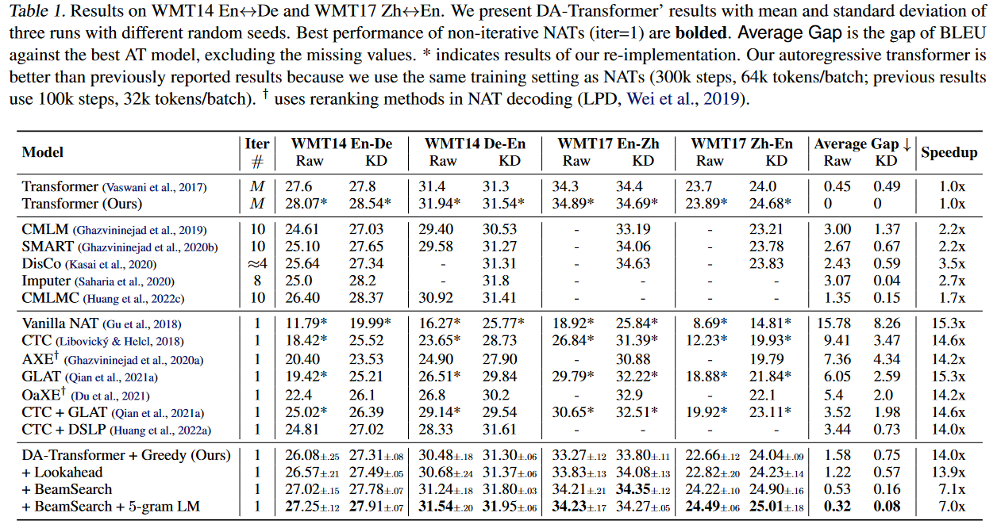
Experiments
Notes:
Better translation quality compared with non-iterative NATs while preserving competitive speedups. Lookahead (parallel) outperforms the best baseline by 2.2 BLEU average.
DA-Transformer achieves 7x-14x speedups over ATs, while remaining gaps are about 0.32 BLEU average. On WMT17 Zh-En, BeamSearch outperform AT by 0.6 BLEU. Dominates all iterative ATs on both BLEU and latency.

Slide 11
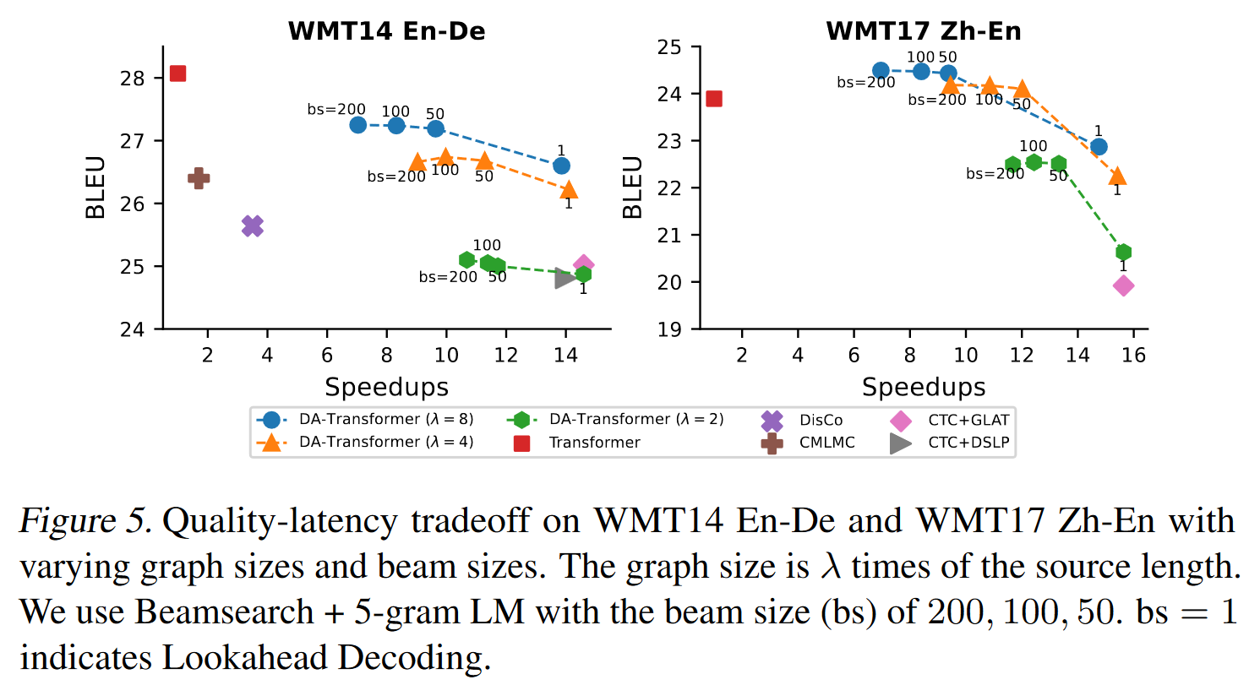
Experiments
Notes:
Quality-latency tradeoff

Slide 12
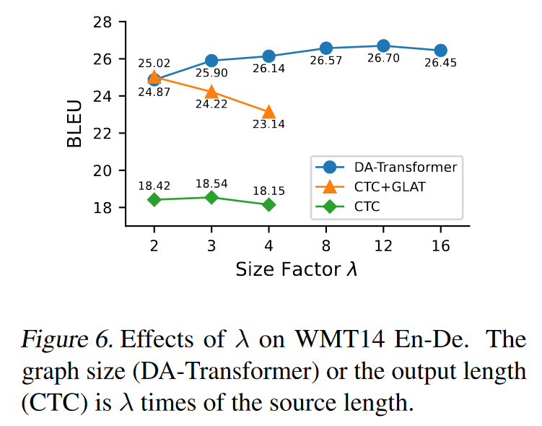
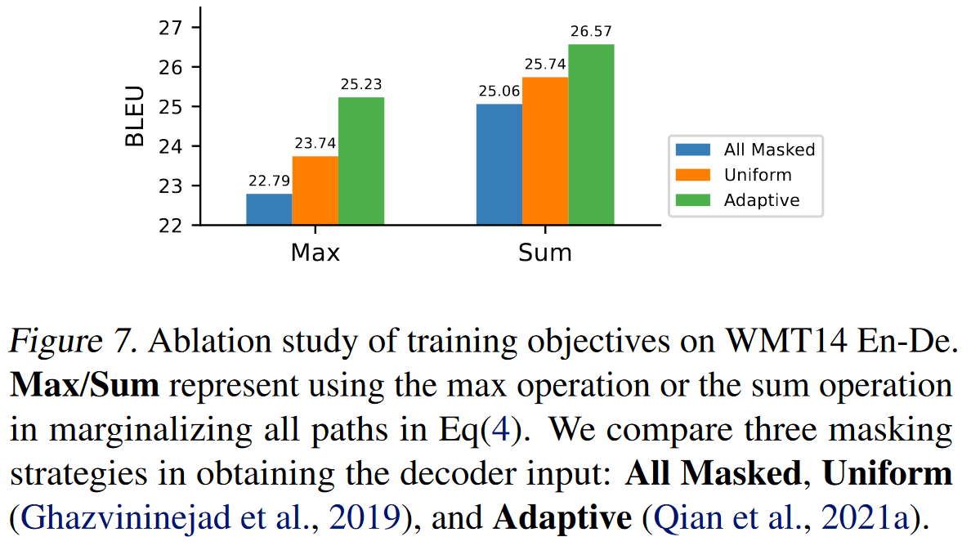
Experiments - Ablation Study
Notes:
Our model can benefit from larger \lambda because our model can utilize different tokens to distinct vertices.
How about using max instead of sum when calculating the probability? So that is optimizing the most probable path vs optimizing all paths with different weights.
In glancing training, you can either not use (all masked) or uniformly randomly mask some token or adaptively choose the masked token according to prediction accuracy.
Sum better than Max: one possibility is that max makes the weight assignments too sharp in the early training, leading to a premature convergence where only several paths are used.
Uniform > None and Adaptive > None: glancing training is better than vanilla training.
Adaptive > Uniform: it can choose the masking ratio dynamically.

Slide 13
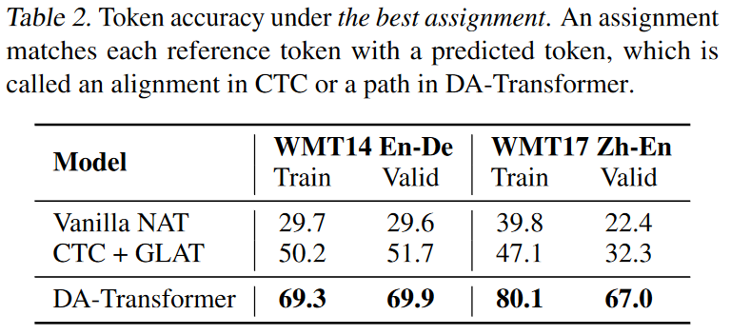
Analysis - token accuracy
Notes:
Our model does not suffer from label inconsistency problem, so our label accuracy is high.
CTC avoids position mismatches by inserting empty or repeated tokens, requiring translations share similar lexical choices, which cannot handle diverse translations.

Slide 14
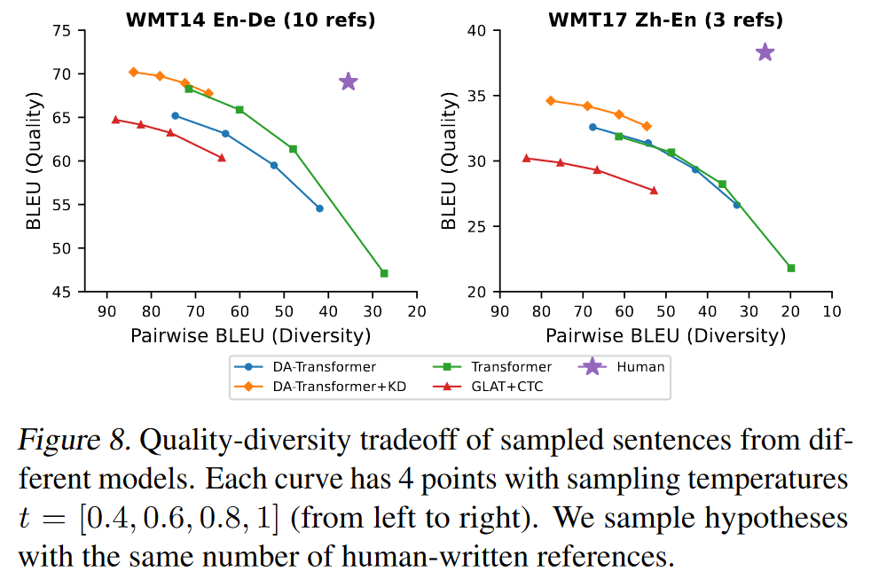
Analysis - diverse generation
Notes:
On the same temperature, our model (w/o KD) can generate far more diverse results than GLAT+CTC.
showing our model can learn multiple diverse translations.
Compared with transformers, our model is slightly less diverse but achieves a close tradeoff.

Slide 15
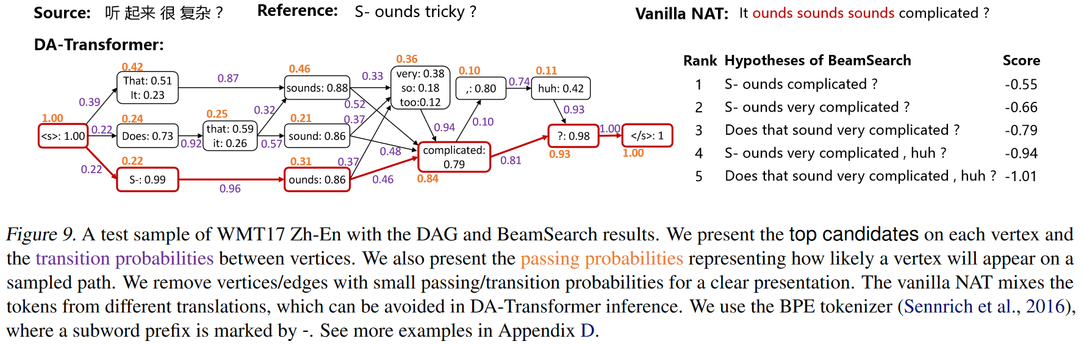
Case Study
Notes:
We remove all vertices with passing probabilities smaller than 0.1.
Passing probability: how likely the vertex will appear on a randomly sampled ath.
Only showing top 90% probabilities.
But there can still have some incorrect sample like "Does that sounds ..."
Which requires more complex grammar.

Slide 16
Conclusion
DA-Transformer: a NAT that captures multiple translations with a directed acyclic decoder.
Experimental results show that it outperforms all NAT baselines and is competitive with AT models.
Why this paper?
"DAG" in its title.
An interesting way to construct a graph from a transformer.
Directly use it for code: how to handle paired tokens?

